Slide 1
Manager as Coach: Start with the Work
Scott Heydon & Lara Anderson
© Copyright 2014 Lean Enterprise Institute. All rights reserved.
Lean Enterprise Institute and the leaper image are registered trademarks of Lean Enterprise Institute, Inc.

Slide 2
Every Organization Must Address
Purpose Provide value to customers (cost- effectively to prosper, etc.)
Process Through value streams that are designed, operated and improved
People By engaging and respecting employees and other stakeholders
→ Aligning purpose, process and people is the central task of management.
Notes:
SAY: Every organization, to achieve it’s purpose, must get alignment between it’s people and it’s processes. And that is management’s central task.

Slide 3
Manager as Coach
“If the Learner Hasn’t Learned,
the Teacher Hasn’t
Taught”

Slide 4
Motion ≠ Work
Value
Creating
Essential
Non-Value
Creating
Work
Human Motion
Waste
-Motion
-Waiting
-Inventory
-Conveyance
-Correction
-Over-processing
-OVERPRODUCTION

Slide 5
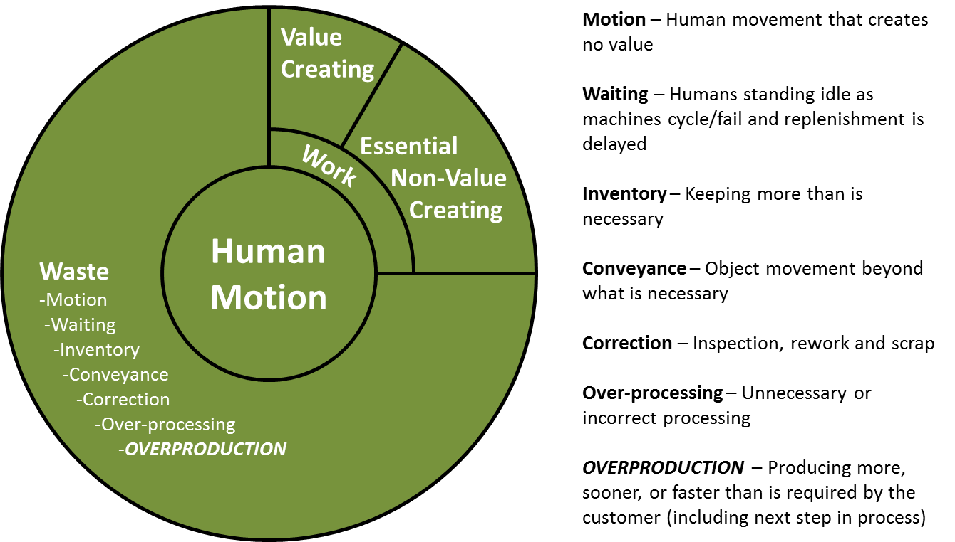
Seven Wastes
Waste
-Motion
-Waiting
-Inventory
-Conveyance
-Correction
-Over-processing
-OVERPRODUCTION

Slide 6
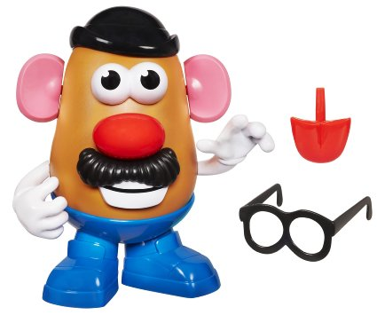
Go and See Activity #2
Write down all steps
Measure the total time
Measure the time of each step
Simple…?
What is missing?

Slide 7
Customer First
Defined as the next step in any process.
Ultimately, the paying end user
Set requirements:
Timing - by when and/or how often (Takt Time)
Quality - precisely and consistently delivered
Price - profit, then, depends on the removal of waste

Slide 8
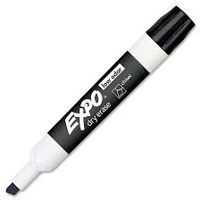
Go and See Activity #1
Write down all steps
Measure the total time
Measure the time of each step
Kroger

Slide 9
Observing Work

Slide 10
Observing Work Activity #2
Once work steps are identified, input to worksheet
Identify start/stop points for each work step
Recommendation: Use points when contact is made – eg. “touch hat” – because they are easier to observe
Observe work multiple times, measuring time of each work step
Recommendation: Observe ten times in order to establish repeatable times
Identify repeatable times (= lowest and repeated most often)
Capture safety, quality, and waste observations in notes

Slide 11
Facilitating Improvement Activity #6
Question Every Detail
Why is it necessary?
What is it’s purpose?
Where should it be done?
When should it be done?
Who is best qualified?
How is ‘best way’ to do it?
Eliminate unnecessary elements
Rearrange elements (layout) for better sequencing (flow)
Add/Subtract elements altogether OR to other jobs (offline)
Combine elements when practical
Simplify all necessary elements to make job easier, faster & safer

Slide 12
Summary of Learning Points
Start first by clarifying customer requirements and standards
Visualizing work (and thinking) fosters collaboration and teamwork, and enables more effective coaching
Initial step toward improvement, attack variability and fluctuation
Involves gaining agreement to work in a consistent way
Understanding work in great detail enables more effective improvement
Manage/coach through asking questions when possible

Slide 13
Creating a “Work Story”
Preparing Oatmeal at Starbucks
Work Step
time (sec.)
Work vs.
Waste
Work
Step

Slide 14
Creating a “Work Story” Activity #3
Transfer the work steps and repeatable times onto the Work Story template
Each work step is “sized” according to its repeatable time
Display hand steps and machine steps separately
Estimate and visualize the percent of each work step that is work vs. waste.
Brainstorm what may be causing the observed waste

